Slide 1
Service Learning
How does it differ from community service?

Slide 2
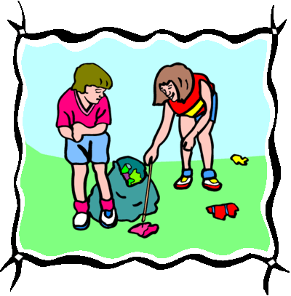
Community Service
A single episode of service
Its duration is short
It may or may not involve a lot of planning
Reflection on the activity is not part of the process

Slide 3
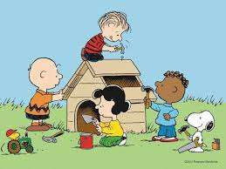
Service Learning
It is a well-planned project that occurs over a period of time
Community stakeholders are included in the process
The project is linked to learning
Reflection is a key component of a service learning project

Slide 4
A typical service-learning project includes five components:
Investigation: Teachers and students investigate the community problems that they might potentially address. Investigation typically involves some sort of research and mapping activity.
Planning and Preparation: Teachers, students, and community members plan the learning and service activities, and address the administrative issues needed for a successful project.
Action (Implementing the Service Activity): The “heart” of the project: engaging in the meaningful service experience that will help your students develop important knowledge, skills, and attitudes, and will benefit the community.
Reflection: Activities that help students understand the service-learning experience and to think about its meaning and connection to them, their society, and what they have learned in school; and
Demonstration/Celebration: The final experience when students, community participants and others publicly share what they have learned, celebrate the results of the service project, and look ahead to the future.
Created by RMC Research Corporation 5 for Learn and Serve America’s National Service-Learning Clearinghouse

Slide 5
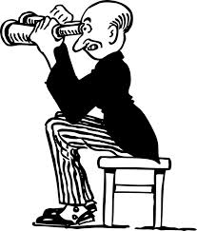
Investigation
What are the community’s needs? (community mapping, newspapers)
What evidence do we have?
Who else do we need to get involved in this project? Community partners?
What skills do I think I will learn from this project (use Targeting Life Skills Model)?
Notes:
Methods of assessing community needs: Mapping, newspaper investigations, brainstorming, attending community meetings

Slide 6
Planning & Preparation
What are our goals (what do we hope to do)?
Who will this project benefit? Why is it important to the community?
What are some specific ideas for things we can do?
How will we know if our project is effective/working?
How will the community know about our group’s project?
How long will it take to organize and complete this project?
How much money will it cost? And where will the money come from?
What has to be done to get this project going (Complete an Action Plan)
How can we make sure everyone who wants to be is involved (even young kids)?
How will we monitor our progress?
Notes:
Are youth actively involved in this process? Are partners actively involved in this process?

Slide 7
Action (action Plan)
Task (What) | Who | By When (date) | Where | How | Cost?
Notes:
The information in this plan should be specific and clear so that everyone knows what they are supposed to do and when. Someone needs to hold people accountable for their tasks.

Slide 8
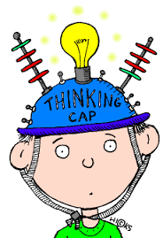
REFLECTIon
What problems did we have?
What did I learn? How did I feel while we were doing the project?
What difference did our project make? I know because….
What have I learned about citizenship?

Slide 9
DEMONSTRATion/Celebration
How can we show the community what has been accomplished?
How can we demonstrate what we have learned?
How are we going to celebrate?
Notes:
What is the impact on the community?
What is the impact on self?
How can you celebrate your accomplishments?

Slide 10
Duration & Intensity*
Service-learning has sufficient duration and intensity to address community needs and meet specified outcomes.
Indicators:
Service-learning experiences include the processes of investigating community needs, preparing for service, action, reflection, demonstration of learning and impacts, and celebration.
Service-learning is conducted during concentrated blocks of time across a period of several weeks or months.
Service-learning experiences provide enough time to address identified community needs and achieve learning outcomes.
*Standards for Service Learning - created by RMC Research Corporation - K-12 Service-Learning Project Planning Toolkit
Notes:
Do we dedicate enough time to our project, by conducting needs assessments, planning, acting, reflecting, demonstrating?

Slide 11
Link to curriculum*
Service-learning is intentionally used as an instructional strategy to meet learning goals and/or content standards.
Indicators:
Service-learning has clearly articulated learning goals.
Service-learning is aligned with the academic and/or programmatic curriculum.
Service-learning helps participants learn how to transfer knowledge and skills from one setting to another.
Service-learning that takes place in schools is formally recognized in school board policies and student records.
*Standards for Service Learning - created by RMC Research Corporation - K-12 Service-Learning Project Planning Toolkit
Notes:
How does this project link to the kinds of things kids are learning in school or in their 4-H projects?

Slide 12
Meaningful service*
Service-learning actively engages participants in meaningful and personally relevant service activities.
Indicators:
Service-learning experiences are appropriate to participant ages and developmental abilities.
Service-learning addresses issues that are personally relevant to the participants.
Service-learning provides participants with interesting and engaging service activities.
Service-learning encourages participants to understand their service experiences in the context of the underlying societal issues being addressed.
Service-learning leads to attainable and visible outcomes that are valued by those being served.
*Standards for Service Learning - created by RMC Research Corporation - K-12 Service-Learning Project Planning Toolkit
Notes:
Is the project meaningful to all of the participants or is it just a work day?
Is reflection about the activity done before, during and after?
Before exercise would be things like “what do I hope to learn?” “What do I think I’ll learn?”
During – what do I feel/think as I complete this project? Will you journal about it or take photos or video?
After – primary reflection activities

Slide 13
Youth Voice*
Service-learning provides youth with a strong voice in planning, implementing, and evaluating service-learning experiences with guidance from adults.
Indicators:
Service-learning engages youth in generating ideas during the planning, implementation, and evaluation processes.
Service-learning involves youth in the decision-making process throughout the service-learning experiences.
Service-learning involves youth and adults in creating an environment that supports trust and open expression of ideas.
Service-learning promotes acquisition of knowledge and skills to enhance youth leadership and decision-making.
Service-learning involves youth in evaluating the quality and effectiveness of the service-learning experience.
*Standards for Service Learning - created by RMC Research Corporation - K-12 Service-Learning Project Planning Toolkit

Slide 14
Partnerships*
Service-learning partnerships are collaborative, mutually beneficial, and address community needs.
Indicators:
Service-learning involves a variety of partners, including youth, educators, families, community members, community-based organizations, and/or businesses.
Service-learning partnerships are characterized by frequent and regular communication to keep all partners well-informed about activities and progress.
Service-learning partners collaborate to establish a shared vision and set common goals to address community needs.
Service-learning partners collaboratively develop and implement action plans to meet specified goals.
Service-learning partners share knowledge and understanding of school and community assets and needs, and view each other as valued resources.
*Standards for Service Learning - created by RMC Research Corporation - K-12 Service-Learning Project Planning Toolkit
Notes:
Have we included community partners in this project?
Why have we included these partners?
What do they have to offer?
What do we have to offer?
Would this project be as effective if we hadn’t included community partners?

Slide 15
Diversity*
Service-learning promotes understanding of diversity and mutual respect among all participants.
Indicators
Service-learning helps participants identify and analyze different points of view to gain understanding of multiple perspectives.
Service-learning helps participants develop interpersonal skills in conflict resolution and group decision-making.
Service-learning helps participants actively seek to understand and value the diverse backgrounds and perspectives of those offering and receiving service.
Service-learning encourages participants to recognize and overcome stereotypes.
*Standards for Service Learning - created by RMC Research Corporation - K-12 Service-Learning Project Planning Toolkit
Notes:
Who is your audience? Who are you working with? Is there diversity within those groups? What have you learned from those you are working with/for?

Slide 16
Reflection*
Service-learning incorporates multiple challenging reflection activities that are ongoing and that prompt deep thinking and analysis about oneself and one’s relationship to society.
Indicators:
Service-learning reflection includes a variety of verbal, written, artistic, and nonverbal activities to demonstrate understanding and changes in participants’ knowledge, skills, and/or attitudes.
Service-learning reflection occurs before, during, and after the service experience.
Service-learning reflection prompts participants to think deeply about complex community problems and alternative solutions.
Service-learning reflection encourages participants to examine their preconceptions and assumptions in order to explore and understand their roles and responsibilities as citizens.
Service-learning reflection encourages participants to examine a variety of social and civic issues related to their service-learning experience so that participants understand connections to public policy and civic life.
*Standards for Service Learning - created by RMC Research Corporation - K-12 Service-Learning Project Planning Toolkit
Notes:
What did I learn about the people I worked with?
What did I learn about myself? My community?
How has what I learned changed my thinking?
How does what I learned relate to other things I know?

Slide 17
Progress Monitoring*
Service-learning engages participants in an ongoing process to assess the quality of implementation and progress toward meeting specified goals, and uses results for improvement and sustainability.
Indicators:
Service-learning participants collect evidence of progress toward meeting specific service goals and learning outcomes from multiple sources throughout the service-learning experience.
Service-learning participants collect evidence of the quality of service-learning implementation from multiple sources throughout the service-learning experience.
Service-learning participants use evidence to improve service-learning experiences.
Service-learning participants communicate evidence of progress toward goals and outcomes with the broader community, including policy-makers and education leaders, to deepen service-learning understanding and ensure that high quality practices are sustained.
*Standards for Service Learning - created by RMC Research Corporation - K-12 Service-Learning Project Planning Toolkit
Notes:
Take videos
Keep journals
Keep statistical information
How do you know how things are going? It’s difficult to assess when you’re in the middle of it. Perhaps assign someone to be the progress monitor, i.e., photographer, videographer, statistician

Slide 18
QUESTIONS?

